Slide 1
Gravitational Fields

Slide 2
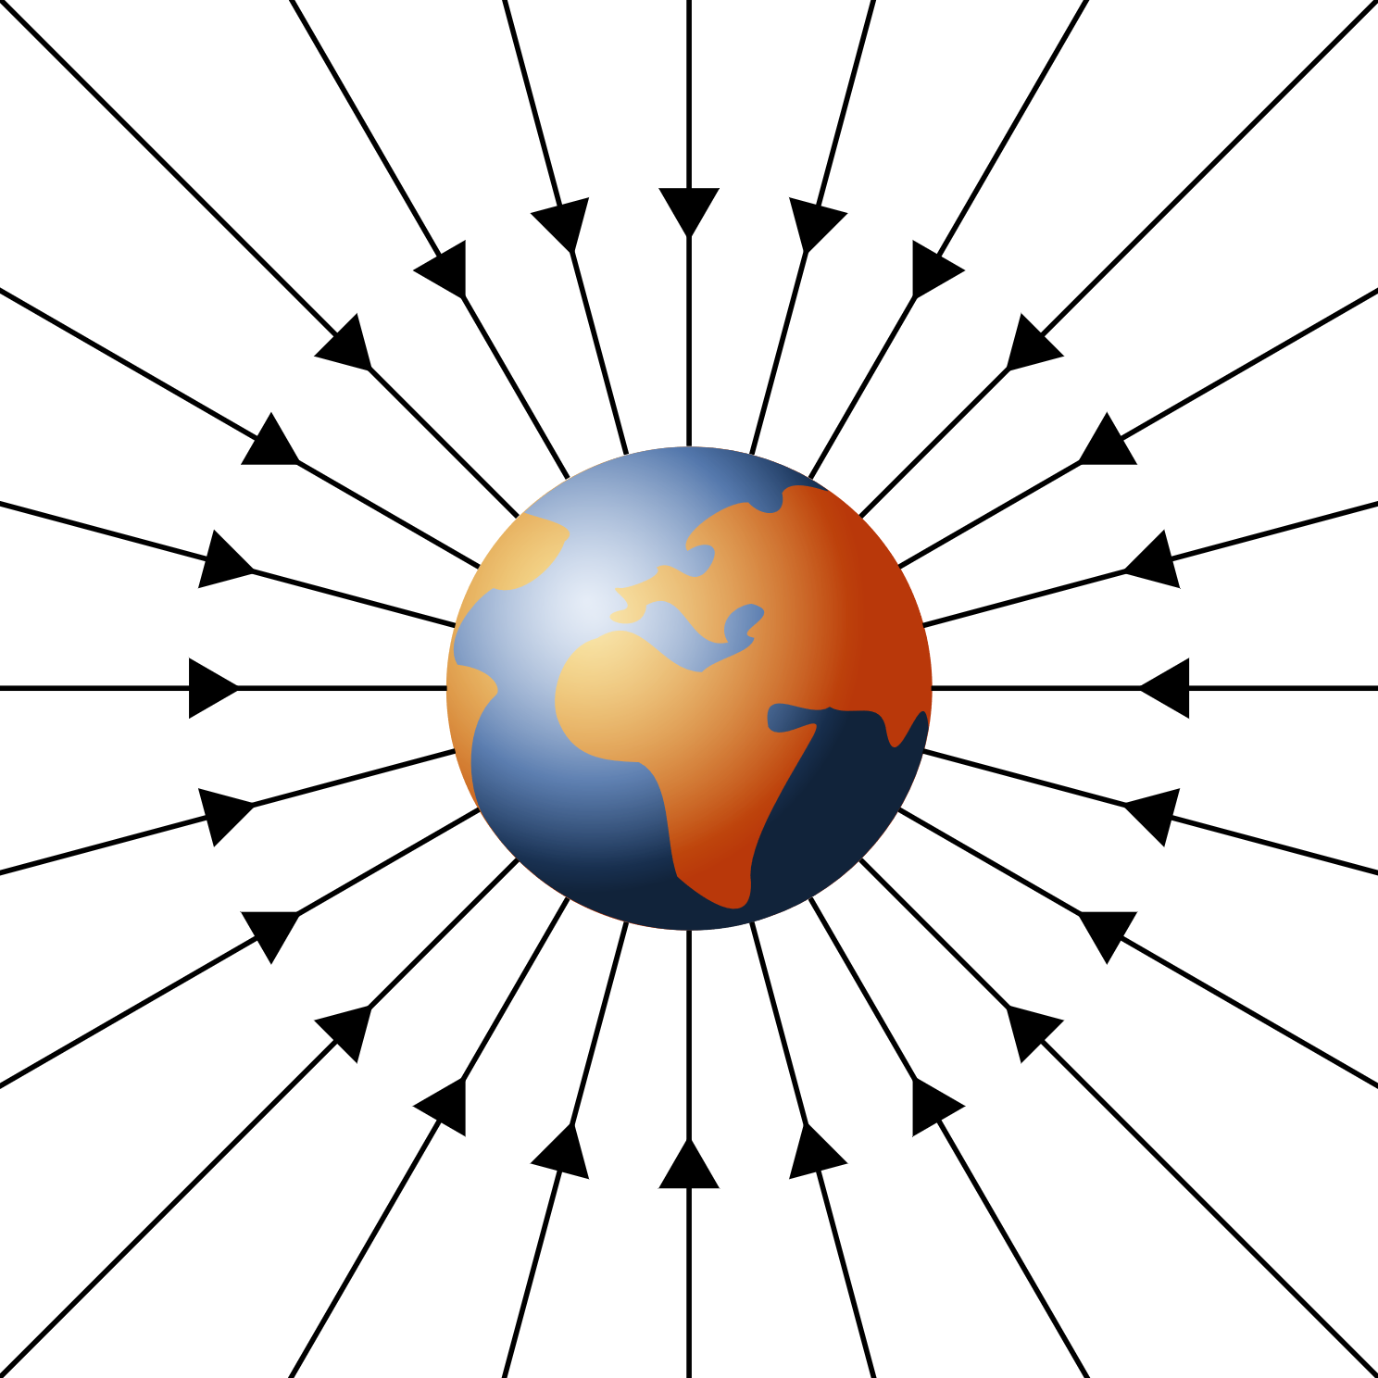
Fields
In physics, a field is a region in which an object experiences a force.
In an electric field, charged objects experience a force.
In a magnetic field, magnetic objects experience a force.
In a gravitational field, objects with mass experience a force.
Gravitational fields are represented by field lines with arrows that show the direction of the gravitational force a massive object will experience at that point.
The closeness of the lines at any point represents the strength of the field at that point.
Because of this, in diagrams with multiple objects, objects with more mass are drawn with more field lines.

Slide 3
Example #1
Consider the two field diagrams below, which represent the gravitational fields around two planets with the same radius. X represents a mass which is exactly the same distance above the planets.
Determine whether each statement is true or false, including an explanation.
Because they have the same radius, the two planets must have the same gravitational acceleration near their surface.
The gravitational force on mass X is weaker above the blue planet.
The mass of the orange planet is less than the mass of the blue planet.
X
X
Notes:
False: The acceleration due to gravity is determined by mass, not radius. The closer field lines indicate that the blue planet has the larger force (and therefore acceleration) due to gravity.
False: The field lines are closer together at point X for the blue planet, so the field is stronger than for the orange planet.
True: The lower number of field lines and the larger distance between them indicates a weaker field, which corresponds to a smaller mass.

Slide 4
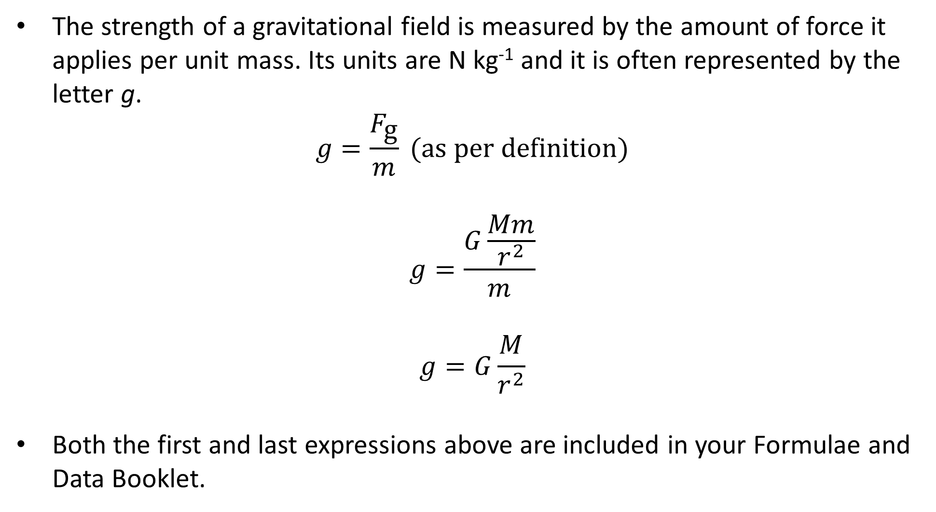
Gravitational Field Strength
The strength of a gravitational field is measured by the amount of force it applies per unit mass. Its units are N kg⁻¹ and it is often represented by the letter g.
$$g=\frac{F_{\text{g}}}{m} (\text{as} \text{per} \text{definition})$$
$$g=\frac{G\frac{Mm}{r^{2}}}{m}$$
$$g=G\frac{M}{r^{2}}$$
Both the first and last expressions above are included in your Formulae and Data Booklet.

Slide 5
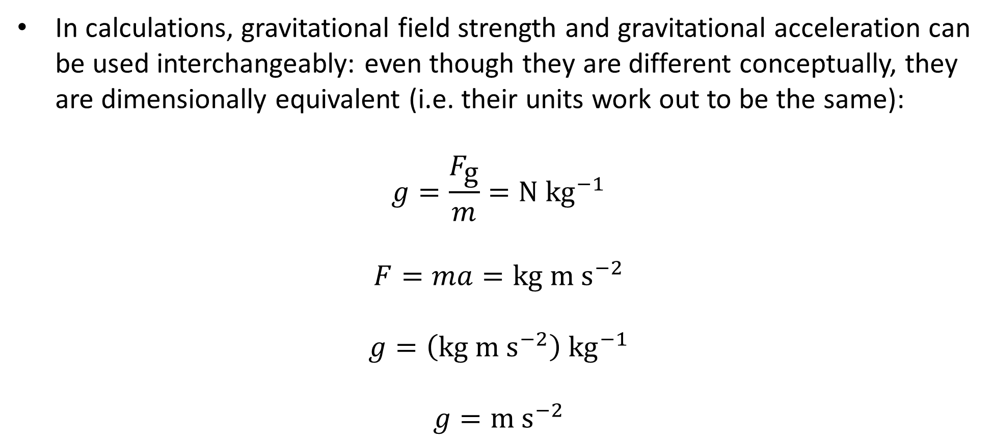
Gravitational Field Strength
In calculations, gravitational field strength and gravitational acceleration can be used interchangeably: even though they are different conceptually, they are dimensionally equivalent (i.e. their units work out to be the same):
$$g=\frac{F_{\text{g}}}{m}=\text{N} {\text{kg}}^{−1}$$
$$F=ma=\text{kg} \text{m} {\text{s}}^{−2}$$
$$g=\left(\text{kg} \text{m} {\text{s}}^{−2}\right) {\text{kg}}^{−1}$$
$$g=\text{m} {\text{s}}^{−2}$$

Slide 6
Example #2
Determine the acceleration due to gravity on a rocket of mass 6.0 × 10³ kg when it is on the Earth and when it is in orbit 250 km above the Earth.
Notes:
9.81, 9.09

Slide 7
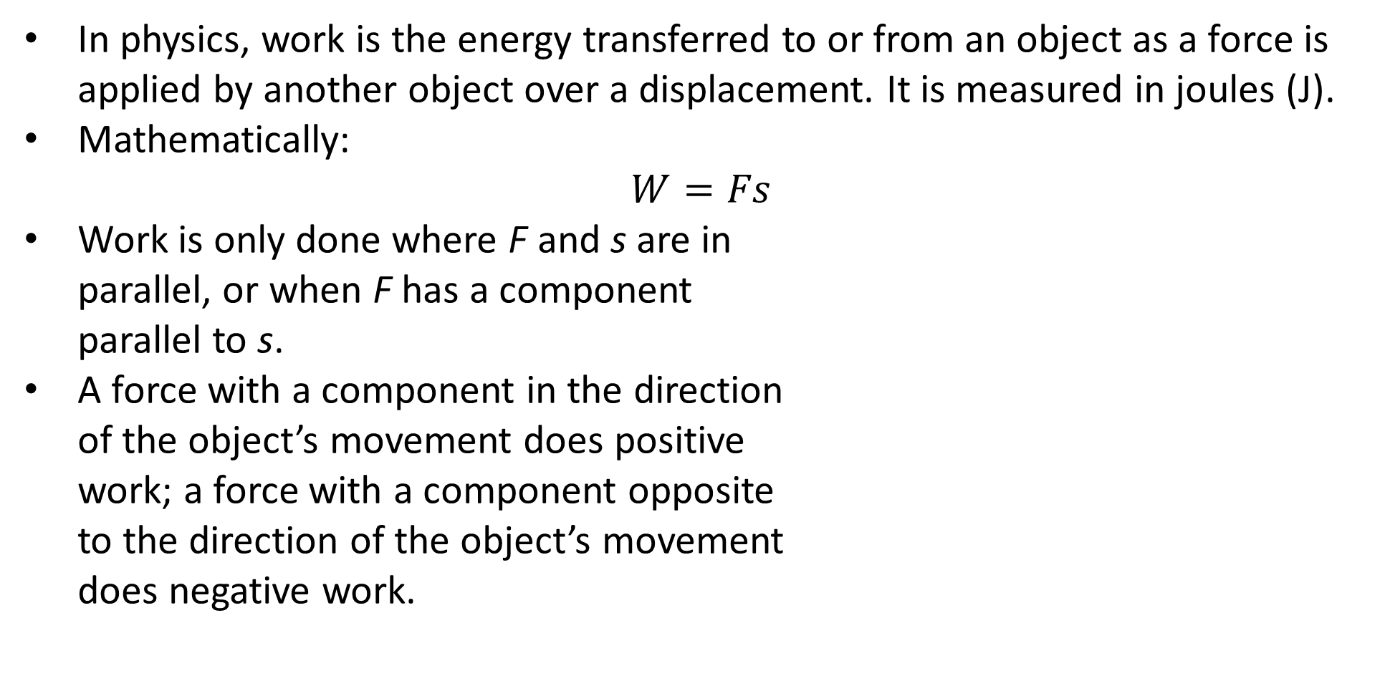
Work
In physics, work is the energy transferred to or from an object as a force is applied by another object over a displacement. It is measured in joules (J).
Mathematically:
$$W=Fs$$
Work is only done where F and s are in parallel, or when F has a component parallel to s.
A force with a component in the direction of the object’s movement does positive work; a force with a component opposite to the direction of the object’s movement does negative work.

Slide 8
Example #3
In which of the situations below is work being done?

Slide 9
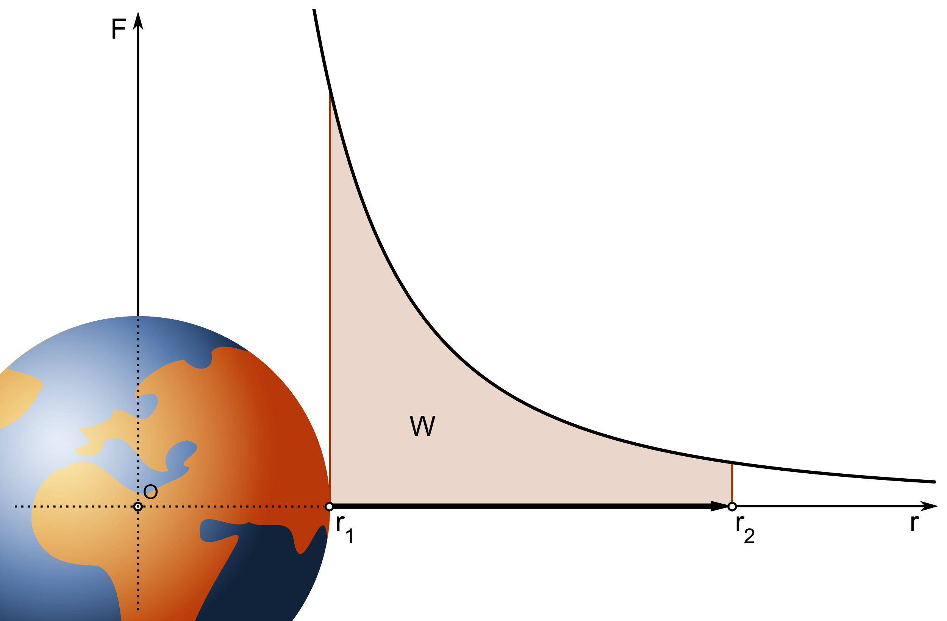
Work in Gravitational Fields
As an object falls down, the gravitational field it is in does work on it.
When an object is lifted, work is done on the object against the gravitational field. The stronger the field, the more work is required.

Slide 10
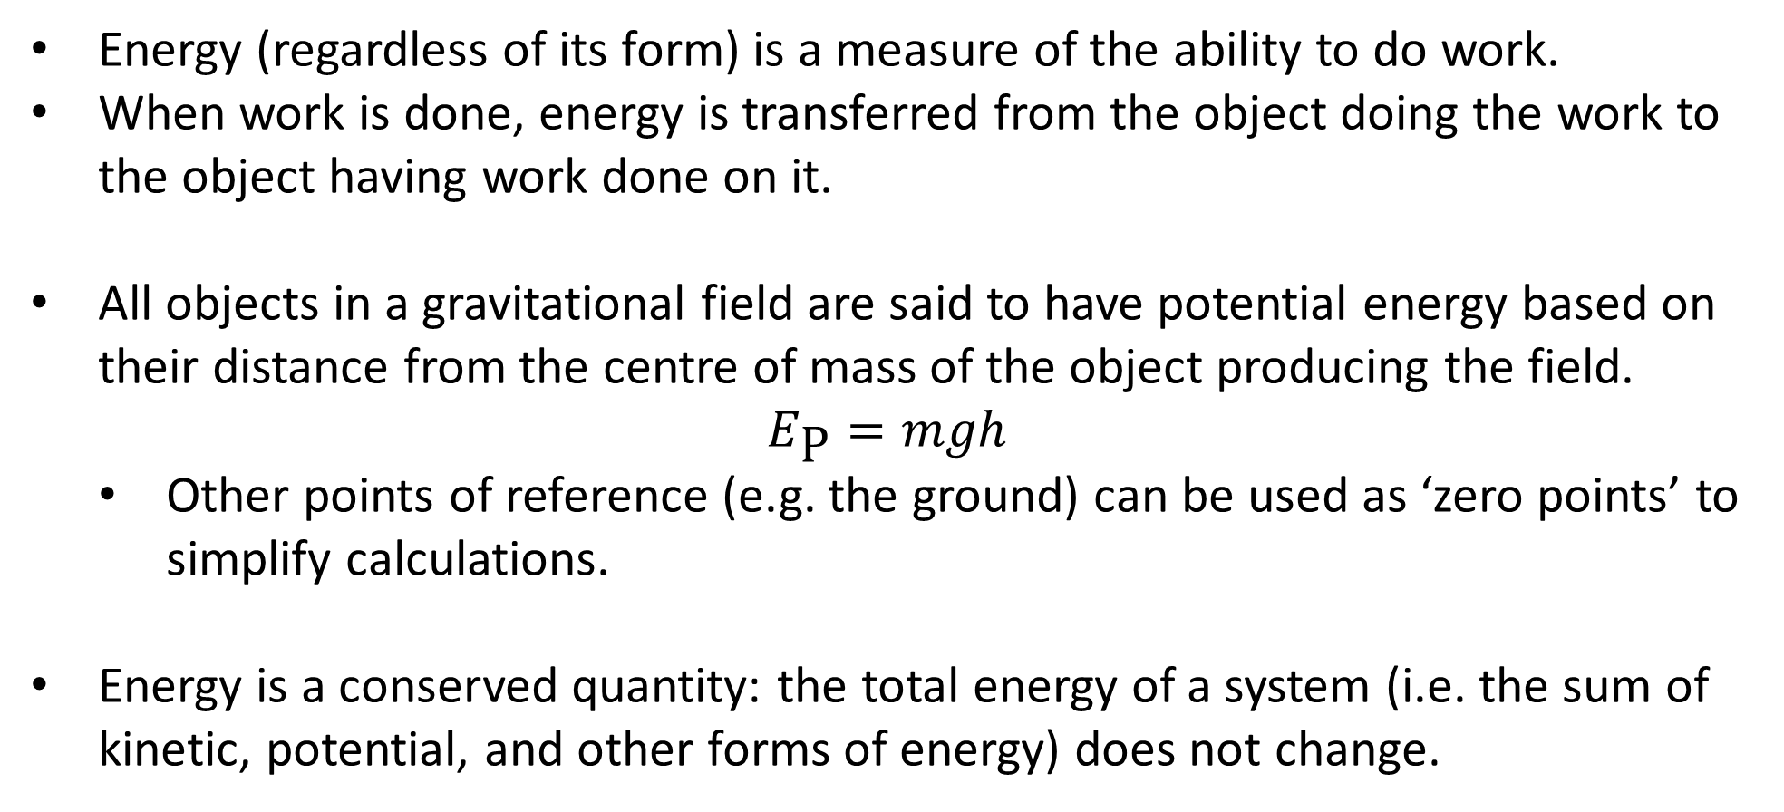
Energy
Energy (regardless of its form) is a measure of the ability to do work.
When work is done, energy is transferred from the object doing the work to the object having work done on it.
All objects in a gravitational field are said to have potential energy based on their distance from the centre of mass of the object producing the field.
$$E_{\text{P}}=mgh$$
Other points of reference (e.g. the ground) can be used as ‘zero points’ to simplify calculations.
Energy is a conserved quantity: the total energy of a system (i.e. the sum of kinetic, potential, and other forms of energy) does not change.

Slide 11
Example #4
A 850 g basketball is shot from a height of 1.70 m with an initial velocity of 4.50 m s⁻¹, at 65° above the horizontal. It goes through the hoop which is 2.50 m above the ground.
Calculate the work done against the ball to the hoop.
Find the velocity of the ball when it passes through the hoop.

Slide 12
Example #5
A 45.0 g golf ball is whacked at an initial velocity of 26.0 m s⁻¹ and reaches a peak height of 22.5 m above its starting height before landing in a water hazard 1.50 m below its starting height. Treat the starting position of the ball as the zero for gravitational potential energy. Using a work/energy-based approach:
Calculate the kinetic energy of the ball at its initial position.
Calculate the ball’s maximum potential energy.
Calculate the ball’s horizontal velocity.
Calculate the velocity of the ball as it lands in the water hazard.

Slide 13
Example #6
A 75.0 kg skydiver jumps out of a plane soaring at an altitude of 2.50 km at a speed of 120 km h⁻¹. Due to the high speeds, air resistance is a significant factor. The terminal velocity of the skydiver is 180 km h⁻¹ which is reached after falling to an altitude of 1.80 km. After this point the skydiver’s speed does not change until the parachute is opened.
Calculate the work done by the gravitational field on the skydiver as he reaches an altitude of 1.80 km.
Calculate the kinetic energy of the skydiver when he reaches an altitude of 1.80 km.
Calculate the work done by air resistance during the descent of the skydiver from the plane to an altitude of 1.80 km.
The skydiver opens his parachute at an altitude of 800 m. He falls vertically and kits the ground at 16.0 m s⁻¹. Calculate the magnitude of the average air resistance which slowed his descent while the parachute was open.

Slide 14
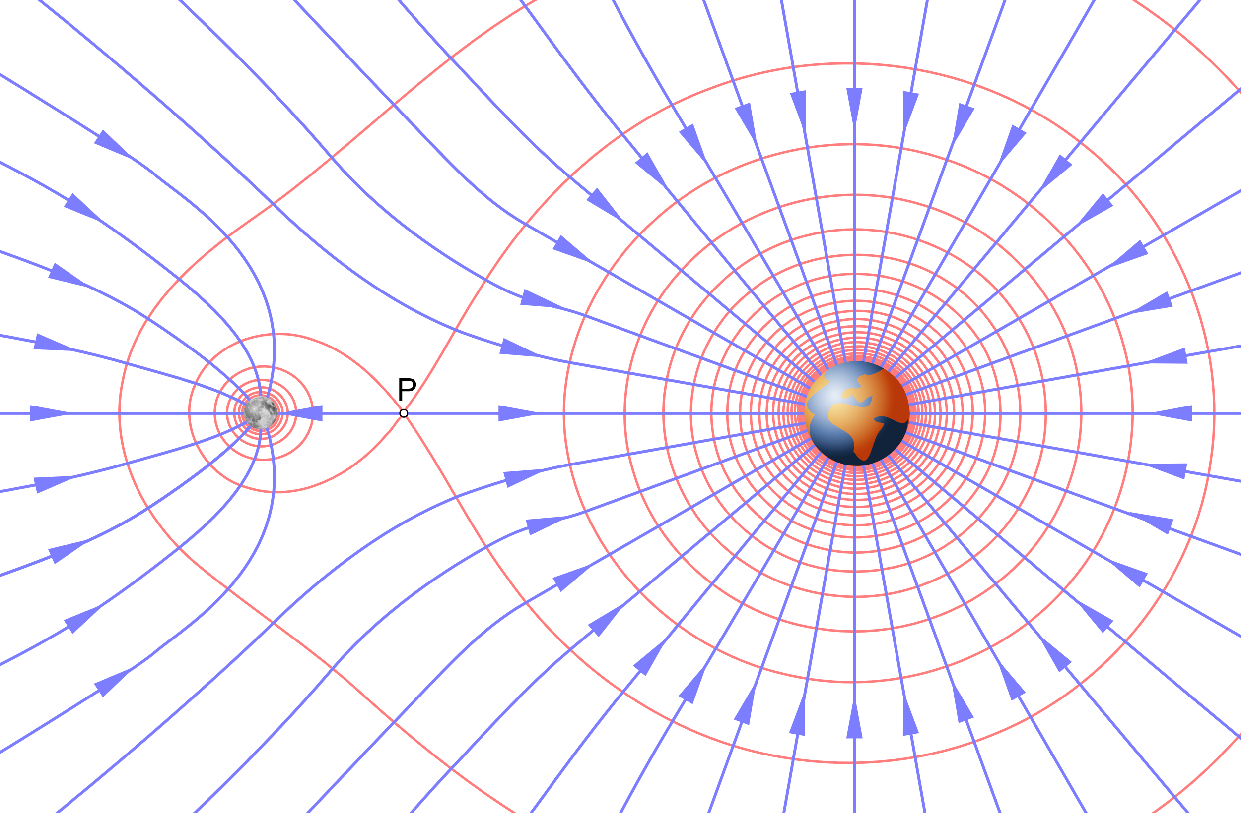
Bonus Question
At what altitude above the Earth could an astronaut sit between the Earth and Moon so that he would not accelerate towards either the Earth or the Moon?
Notes:
3.456 × 10⁸ m

